Slide 1
Training an AI to Solve a Maze
Guide : Mrs D. Krishna Madhuri
By
Dhanush, Rahul, Chethan, Gautham

Slide 2
TOC
Abstract
Existing System
Limitations of Existing System
Proposed System
Advantages of Proposed System
Project timeline

Slide 3
Abstract
The Project describes the approach of solving Maze problem with Genetic Algorithm. The method is implemented and found to be effective for the maze structures.The proposed algorithm reflects the process of natural selection where the fittest individuals are selected for reproduction in order to produce offspring of the next generation
The process of natural selection starts with the selection of fittest individuals from a population. The current generation produce offspring which inherit the characteristics of the parents and will be added to the next generation. If parents have better fitness, their offspring will be better than parents and have a better chance at surviving

Slide 4
Existing System
In order to find a path through maze A* Search it requires each tile of one unit size when no obstructions in the path it forwards adjacent blocks till it reaches the goal.

Slide 5
Limitations of Existing System
01
The main drawback of A* algorithm and indeed of any best-first search is its memory requirement
02
A* algorithm is severely space-limited in practice, and is no more practical than best-first search algorithm on current machines
03
It exhausts available memory in a matter of minutes

Slide 6



Proposed System
A genetic algorithm is a search heuristic that is inspired by Charles Darwin's theory of natural evolution.
This algorithm reflects the process of natural selection where the fittest individuals are selected for reproduction in order to produce offspring of the next generation.

Slide 7
Advantages of Proposed System
01
The capability of Genetic Algorithm to be implemented as a 'universal optimizer' that could be used for optimizing any type of problem belonging to different fields.
02
Proper balance between exploration and exploitation makes Genetic Algorithm Simple and easy to implement.
03
Mathematical or theoretical analysis in terms of schema theory or Markov chain models makes Genetic Algorithm one of the pioneer evolutionary algorithms.

Slide 8
Modules
The project consist of four main modules
Mini
Sets up everything for the program to run .
Brain
It sets the direction vectors and mutate the brains of the dots.
Dot
It has the data of all the dots in present generation and responsible for the movement of the dots.
Population
It is responsible for making the calculations required for the next generation.

Slide 9
Brain Module
It sets the direction vectors and mutate the brains of the dots.
It consists the following functions
Randomize().
Clone().
mutate().

Slide 10
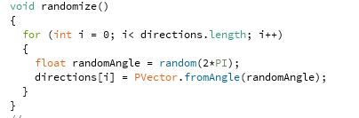
Randomize()
This function sets all the vectors in the directions to a random vector with length 1

Slide 11
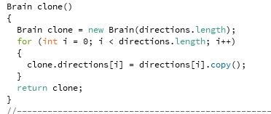
clone()
This function returns a perfect copy of this brain object.

Slide 12
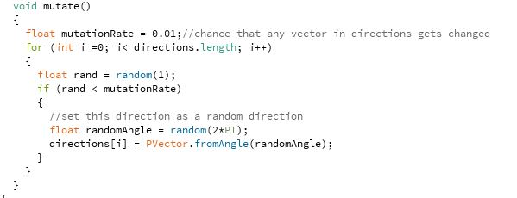
Mutate()
This function mutates the brain by setting some of the directions to random vectors.
The chance that any vector in direction gets changed is 1%

Slide 13
Dot Module
It has the data of all the dots in present generation and responsible for the movement of the dots.
It consist of four function
Move()
Update()
CalculateFitness()
GimmeBaby()

Slide 14
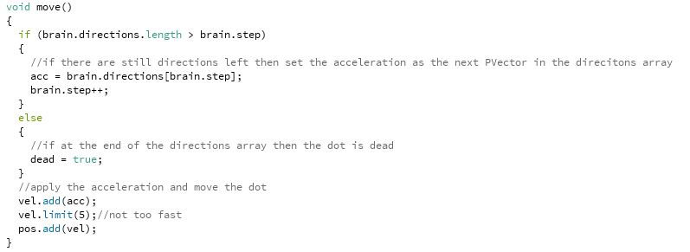
Move()
This function moves the dot according to the brains directions.

Slide 15
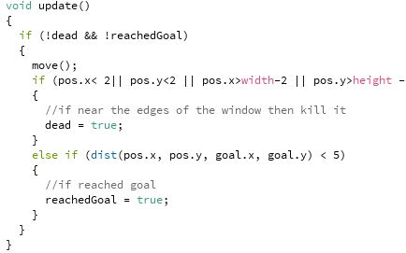
Update()
This function calls the move function and check for collisions

Slide 16
CalculateFitness()
This function calculates the fitness of each dot.

Slide 17
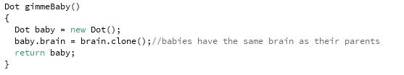
GimmeBaby()
This function clone the dot. But this function does not mutate the brain.

Slide 18
Population Module
It is responsible for making the calculations of each and every dot required for the next generation.
It consist of eight functions
Update()
CalculateFitnesses()
AllDotsDead()
NaturalSelection()
CalculateFitnessSum()
SelectParent()
MutateDemBabies()
SetBestDot()

Slide 19
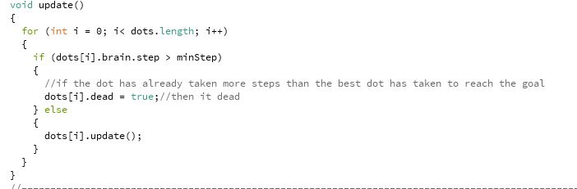
Update()
This function updates all the dots and also responsible for terminating the dot has already taken more steps than the best dot has taken to reach the goal

Slide 20
CalculateFitnesses()
This function calculate all the fitnesses

Slide 21
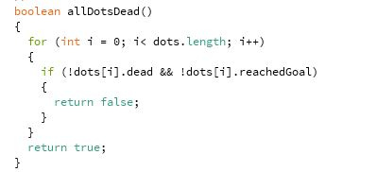
AllDotsDead()
This function returns whether all the dots are either dead or have reached the goal.

Slide 22
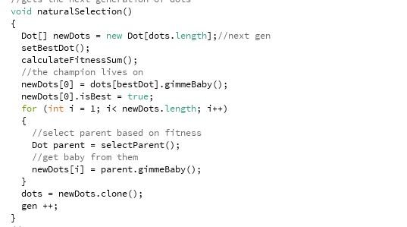
NaturalSelection()
This function gets the next generation of dots

Slide 23
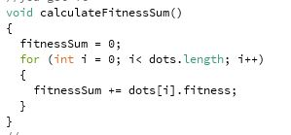
CalculateFitnessSum()
This function Calculates the sum of all Fitnesses

Slide 24
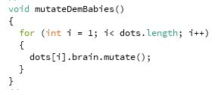
mutateDemBabies()
This function mutates all the brains of the babies.

Slide 25
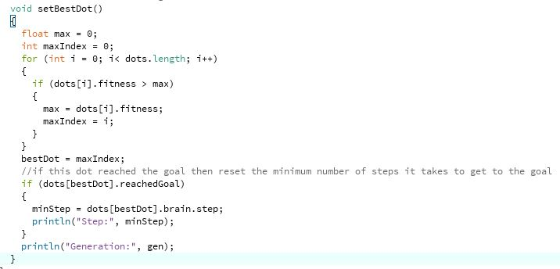
setBestDot()
This function finds the dot with the highest fitness and sets it as the best dot.

Slide 26
References
Daniel Shiffman
http://www.shiffman.net
An Introduction to Genetic Algorithms - Melanie Mitchell
The author gives a simple overview of genetic algorithms and a wide range of applications. I comment the book is a perfect introductory book for genetic algorithms.

Slide 27
Technologies Used
JavaScript
JavaScript, often abbreviated as JS, is a high-level, interpreted programming language that conforms to the ECMAScript specification.
Krita
A popular software to create high quality graphics.
Processing 3
A flexible software sketchbook

Slide 28
Project timeline
DEC
JAN
FEB
MAR
Planing
Building
Documentation
Submission

Slide 29
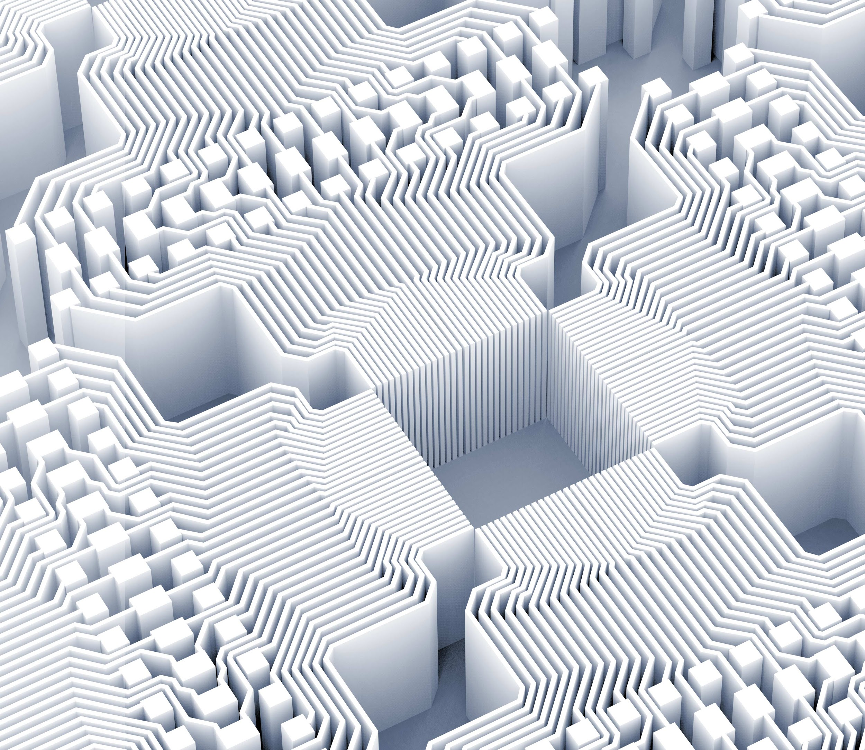
Thank you!

